Slide 1
Lecture 15:
Environmental Movements and Politics in India
Course: Environment and Politics in India

Slide 2
Environmental Movements in India
Forests: For Whom and for What?
April 1973: Chipko movement ‘Outside’ commercial interests versus local fuel/food/fodder needs
Protests against commercial logging (Bihar, Orissa, Madhya Pradesh, Maharashtra, Karnataka)
Environmental protests -> Demands for political autonomy, control over local resources.
Background: Forest Act. POLITICAL, SOCIAL, ECOLOGICAL watershed.
1980s: Protests against monocultures. ‘Pluck and Plant’/Jungle Kato campaigns in Karnataka, Jharkhand, Uttarakhand.
Players? Farmers, reed workers, bamboo workers, rope makers, artisans, nomads, hunter-gatherers, peasants
Protests over Tendu leaves (income/wages/rights)
COORDINATED protests over the Draft Forest Bill of 1982 (NCA recommendations)
Debates over the Forests Rights Act

Slide 3
Environmental Movements in India
Mulshi Satyagraha
A strong sense of wrong and deep feeling of resentment among the peasantry whose lands are affected by the project, against the Government for sanctioning the scheme more than two years ago, without taking them in its confidence, i.e., without consent, knowledge or consultation of the peasant-owners of the land.. .
Suspicion and distrust in both the Government and the Company, due chiefly to the procedure of acquisition, as to the bonafides of their intentions to award full compensation, or equivalent . . . land somewhere else, and other facilities already enjoyed by them or necessary for fresh colonization . . .
Reluctance to part with the land on account of its extreme productivity, the natural facilities of irrigation and nominal amount of land revenue.
Reluctance to part with lands, ancestral homes, and traditional places of worship and see them submerged under water.
Natural reluctance in this class of peasantry to emigrate from one place to another . . .

Slide 4
Environmental Movements in India
Mulshi Satyagraha
One and a half lakh (1,50,000) electrical horse-power would be created by the Mulshi Peta dam.
It would save 525,000 tons of coal (and lots of money) every year. The saving of coal means a corresponding saving of Rs. 1,05,50,000 worth of fuel to the mill industry of Bombay.
The quantity of coal saved would require 26.250 wagons for transport. These would be saved and utilized for other public purposes.
Water once used can be directed for agricultural purposes after electrical power is created.
Electricity thus created would give work to 300,000 labourers. If it is utilized for cotton mills, every day 51 lakh yards would be manufactured.
The projected electrification of the Bombay suburban railway lines would give to Bombay city much faster and more frequent trains, thus enabling the development of housing schemes in purer air and healthier circumstances.
- From The Times of India, 2 May 1921

Slide 5
Environmental Movements in India
Dams and the Damned
Mulshi Satyagraha and contemporary parallels. Senapati Bapat versus Brahmin landlords of Pune/power company and the State
  Narmada Bachao Andolan. Gujarat versus Madhya Pradesh
  Tehri
  Koel Karo
  Silent Valley
  Bhopalapatnam-Inchampalli
  Different trajectory, different response: Bedthi dam in Uttar Kannada
Economic, social, ecological, (weak) political opposition
Politics of Pitting: Drinking water versus land, wick lamps versus lights in latrines

Slide 6
Environmental Movements in India
Struggles in the River/Sea
Clashes between artisanal fisherfolk and modern trawlers
Blue revolution
Strikes, processions, violent clashes, calls for ban on trawlers
Ganga Mukti Andolan: Against feudal ‘panidari’ rights AND against industrial effluents

Slide 7
Environmental Movements in India
Mines and Misery
Displacement, deforestation, drying up of water sources
Limestone quarrying in the Doon Valley. NIMBY protests such as ‘Save Mussoorie’, ‘Friends of the Doon’
Sangharsh Samitis in Kumaon against stone quarrying
Gandamardhan
POSCO
Niyamgiri
Essar, coal mining, Priya Pillai

Slide 8
Environmental Movements in India
Water Pollution
Grasim Rayons in Nagda
Orient Paper Mills
Pollution in the Tungabhadra
Tanneries in Ambur
Protest against MIDC/distilleries

Slide 9
Environmental Movements in India
QUESTION: What are the forms of political action by environmentalists? What has been the role of established ‘political parties’?
Dharna, Pradarshan, Gherao, Rasta Roko, Jail Bharo, Bhook Hartal, Sangharsh Yatra, Jal Samadhi, Padyatra, Ecological Restoration
EXAMPLES:
First environmental padayatra (1982-83): Trans-Himalayan march from Kashmir to Kohima, covering 4000 km by Sunderlal Bahuguna
Save the Western Ghats March (1987-88): Along a 4000 km. long mountain chain, 600 villages, 150 organizations, several states (Kerala, Karnataka, Maharashtra, Goa, Tamil Nadu)
Restoration: Bali Raja memorial dam, Ralegaon Siddhi, Afforestation, check dams, energy-saving household devices etc.

Slide 10
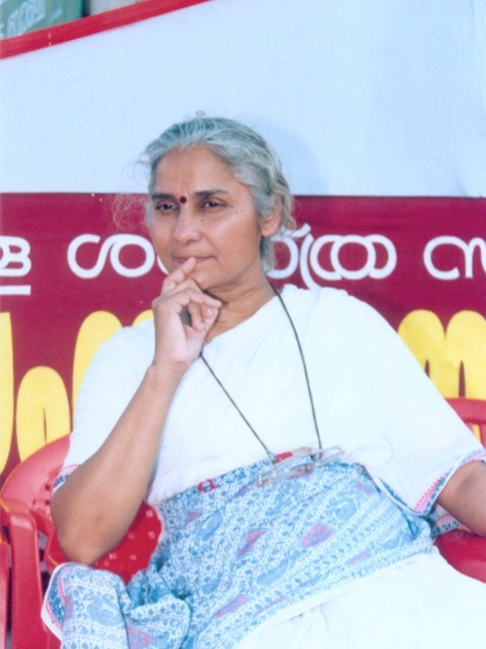
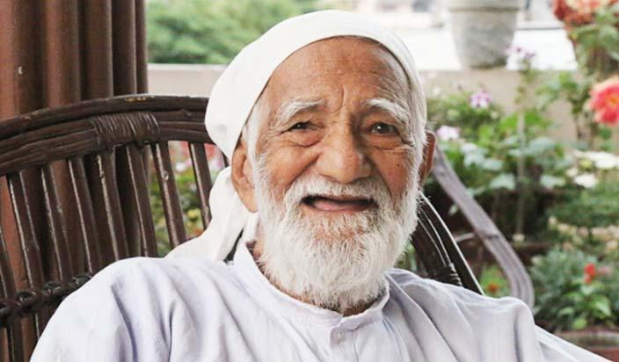
THREE strands of environmentalism
Gadgil and Guha’s categorisation
CRUSADING GANDHIANS
Reject the “modern” and “Western” way of life
Reject materialism and consumerism
Root for a return to the pre-capitalist AND and pre-colonial village society

Slide 11
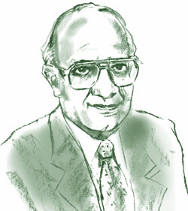
THREE strands of environmentalism
APPROPRIATE TECHNOLOGISTS
Influenced by ‘western socialism’
Strive for a synthesis of agriculture and industry, big and small units, and Western and Eastern technological traditions
EXAMPLE: Dashauli Gram Swarajya Mandal in Uttarakhand
Reddy: Energy for a Sustainable World

Slide 12

THREE strands of environmentalism
ECOLOGICAL MARXISTS
“Polar opposites” of the Crusading Gandhians.
Explicitly identify class as a contradiction in society.
“Unremitting hostility to tradition”, “faith in modernity and modern science”
Focus on industrial pollution and workplace safety.
EXAMPLES: Uttarakhand Sangharsh Vahini, KSSP (Science for Social Revolution)

Slide 13
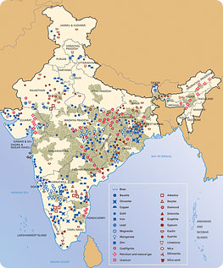

Slide 14
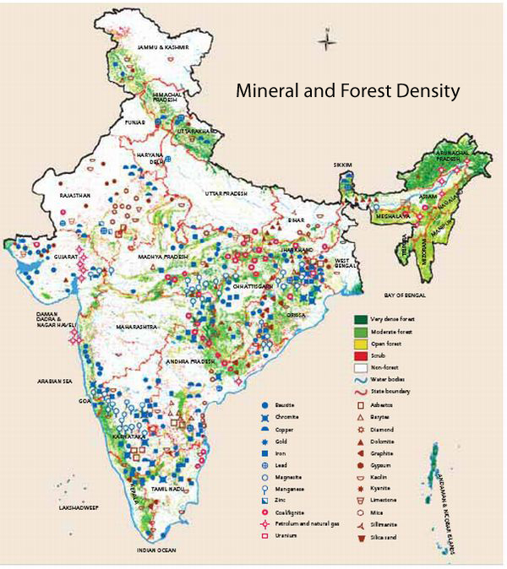

Slide 15
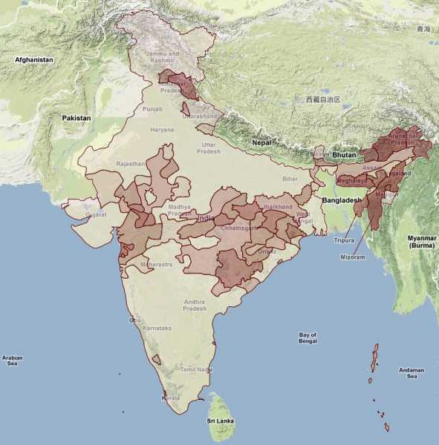

Slide 16
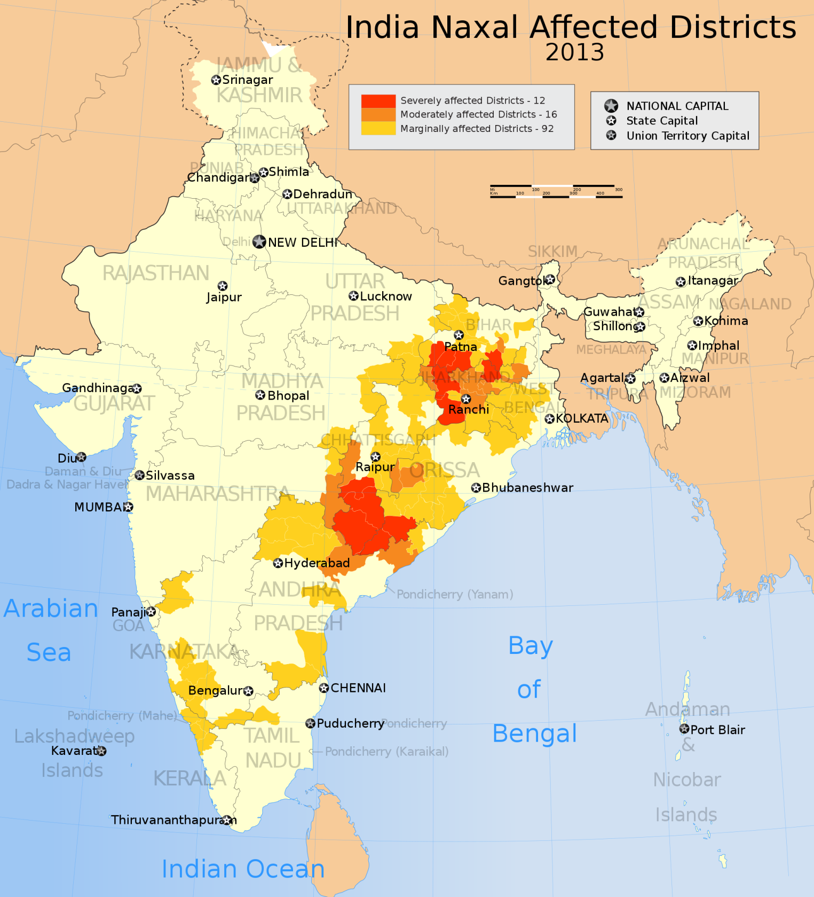

Slide 17
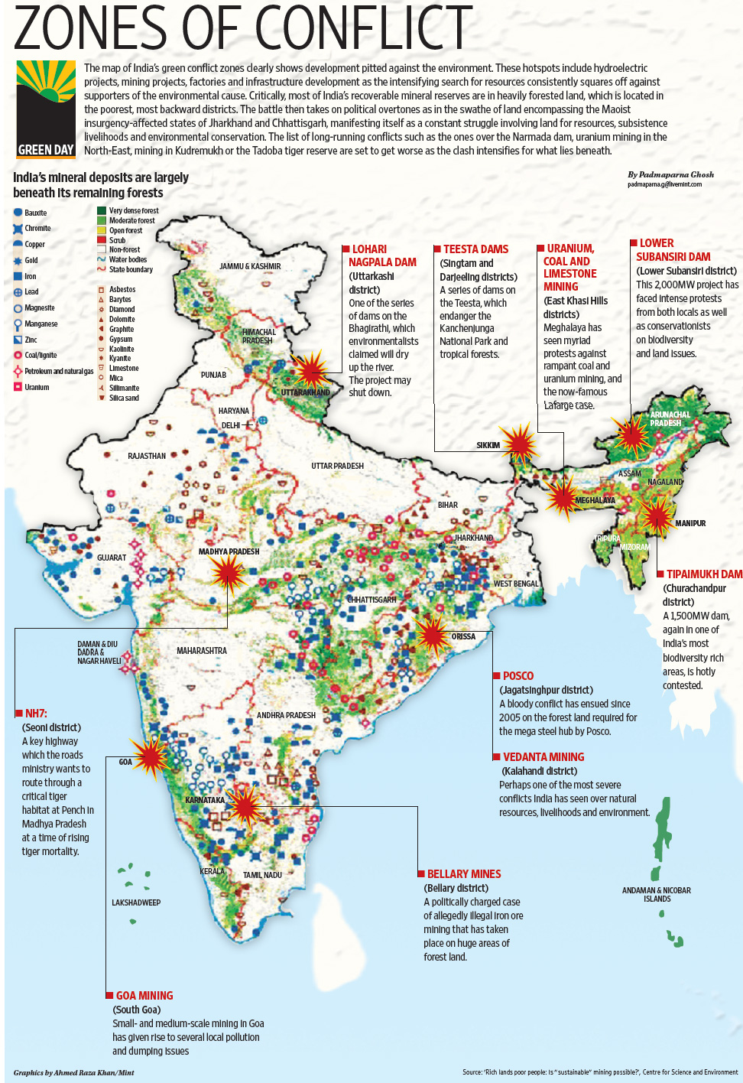

Slide 18

Jharkhand Mukti Morcha
JMM:
Maaro Mahajan, Maaro Daroga, Fasl Jabt, Zameen Jabt, Jungle Kato
Tribal alienation from land
Control over forests/water resources
Opposition to displacement
Participation in decision-making
Jobs for locals
THREE leaders, THREE mass bases, THREE visions:
A.K. Roy, Shibu Soren, Binod Bihari Mahato

